Slide 1
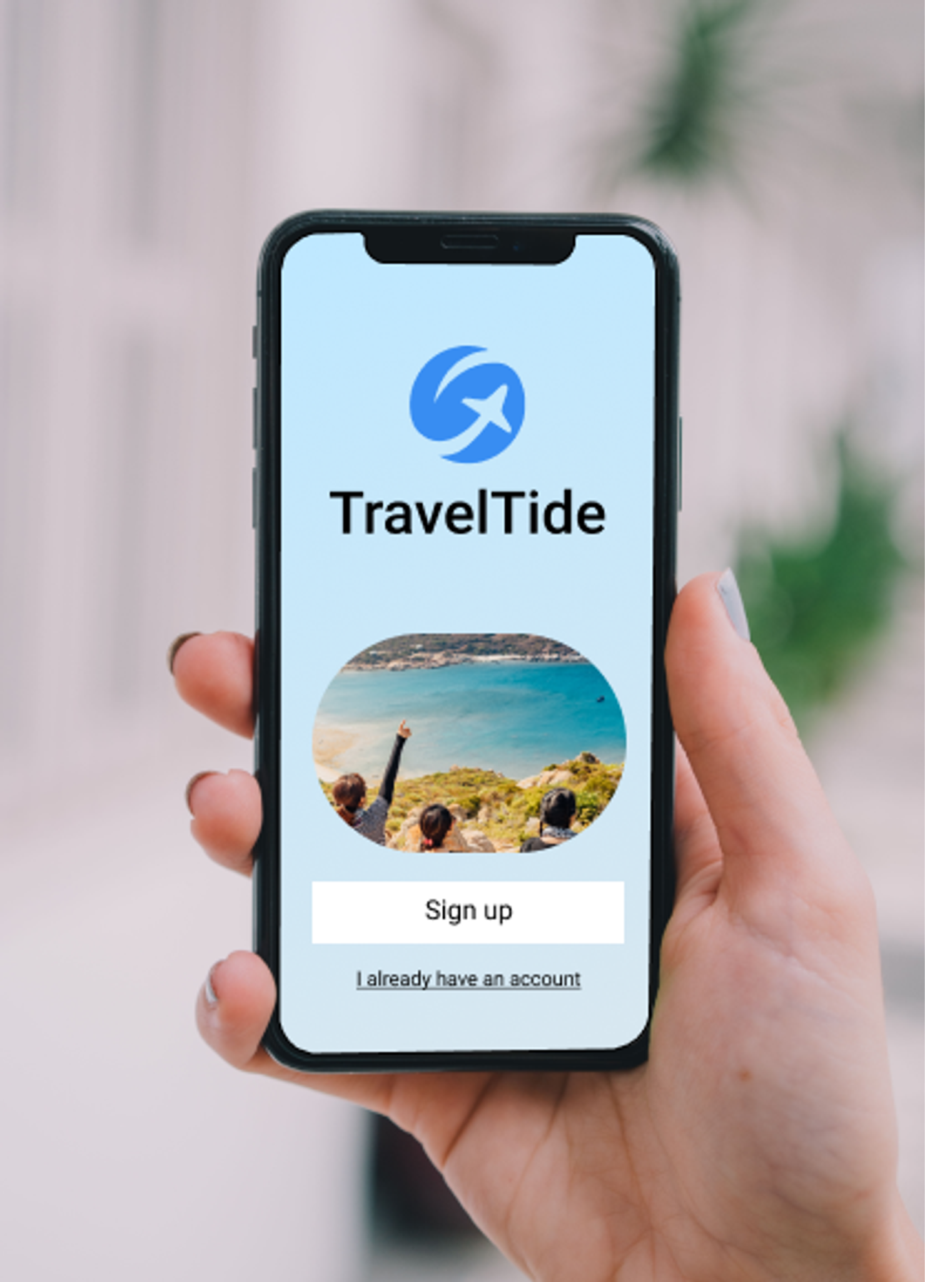
Travel Tide Reward Program
User Segmentation and &
Perk Assignment
Personalizing Travel Perks with Data:
Final Project Presentation
Analyst: Andrea Cigrovski
Date: 11.07.2025

Slide 2
Project Overview
Objective: Use data-driven insights to personalize perks for TravelTide users based on their behavior and demographics.
Goals:
Segment users with clustering (K-Means & DBSCAN)
Assign a tailored perk to each user
Create visual insights for stakeholder decision

Slide 3
Data & Methodology
Dataset Highlights:
15+ user behavior & profile features
100 users sample (for processing)
Key Techniques Used:
Preprocessing & Feature Scaling
PCA for dimensionality reduction
K-Means and DBSCAN for clustering
Mapped clusters to relevant travel perks

Slide 4
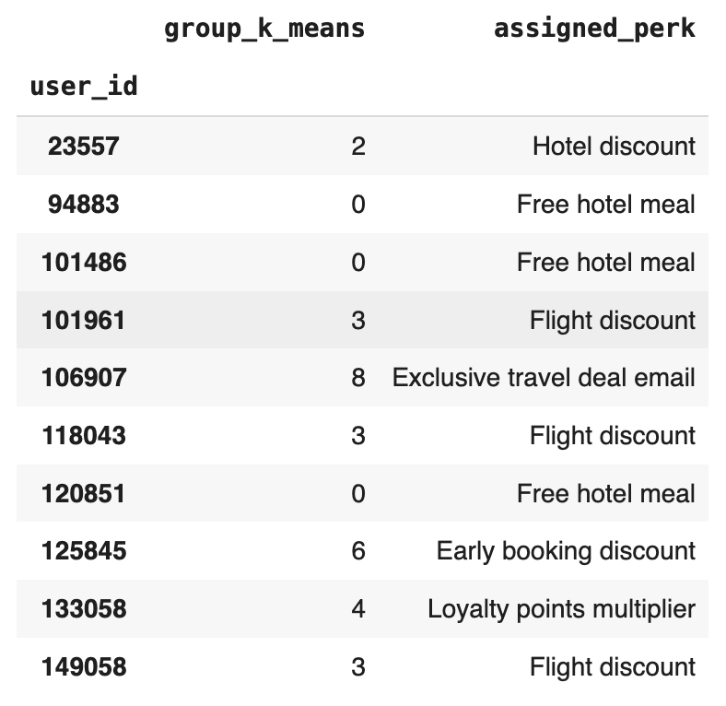
Clustering & Perk Assignment
K-Means Clusters → Assigned Perks:
✅ Each user received a personalized
perk based on cluster assignment.
🎯 Goal: To personalize the travel reward experience by
assigning each user a perk that aligns with their
Behavior and needs, thereby increasing engagement and
conversion.
🧩 Method: Users were grouped into 9 clusters using K-Means.
Each cluster was mapped to a tailored perk based on user
characteristics

Slide 5
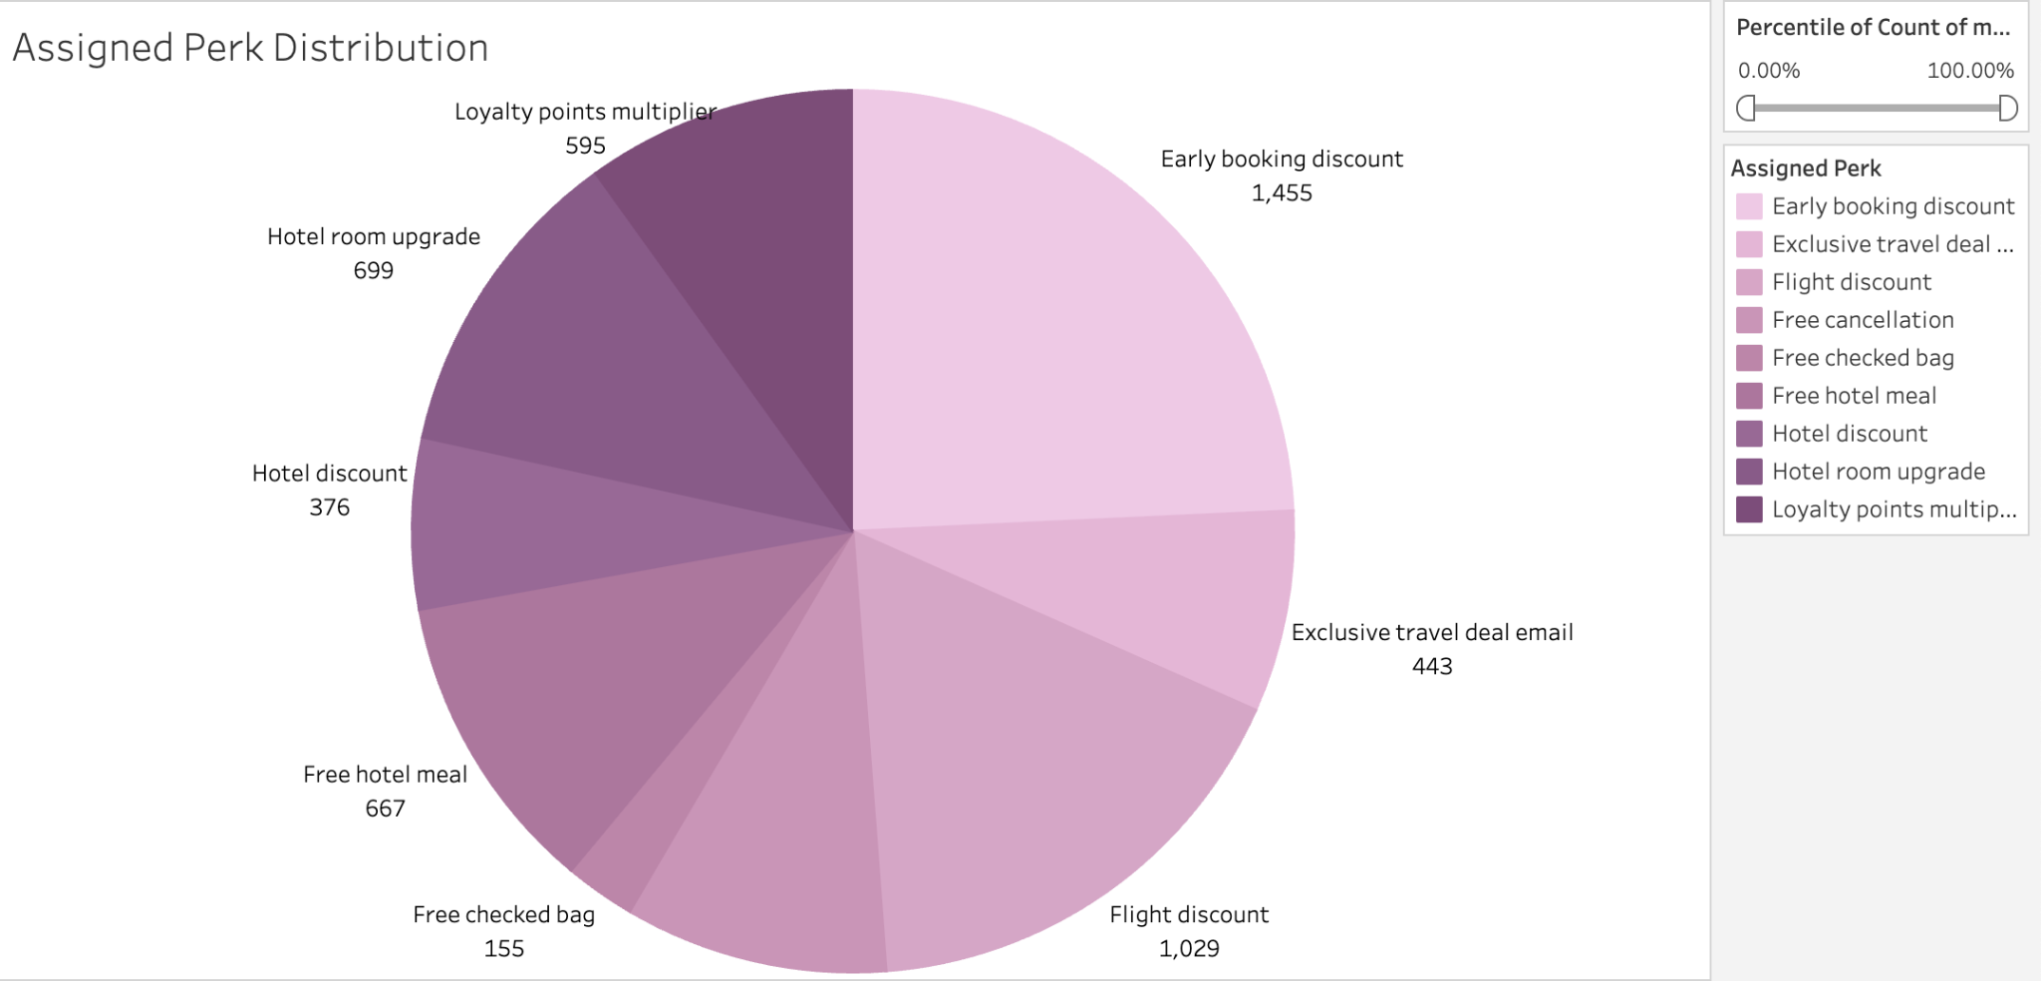
Insights from
Visualizations:
We now see a pie chart that
shows
what number of users are
assigned to each perk.

Slide 6
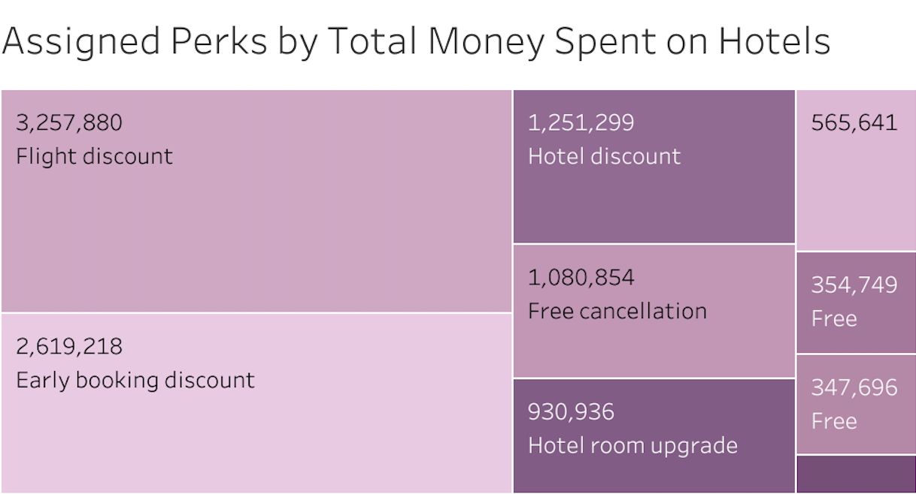
📊 What This Shows:
We see which perks were
assigned to users who bring
the most hotel revenue — for example “Early booking discount” or “Flight discount” dominate because they align with high-spending Segments..

Slide 7
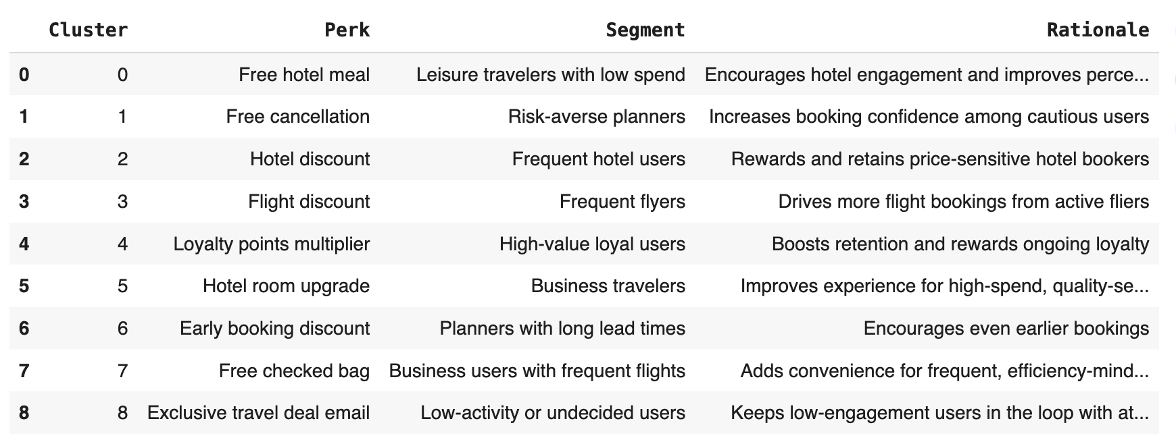
A mapping table provides the assigned perk, the target segment, and the business rationale.

Slide 8
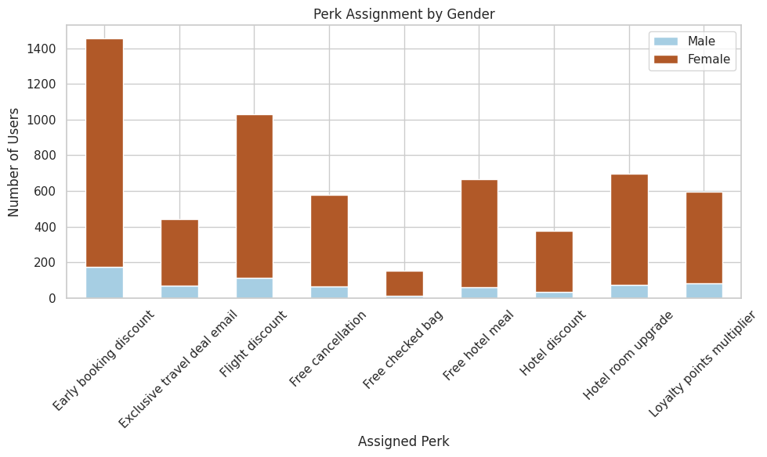
This stacked bar chart shows how each assigned perk was distributed between male and female users. This visualization helps identify any potential gender-based preferences or trends in perk assignments.

Slide 9
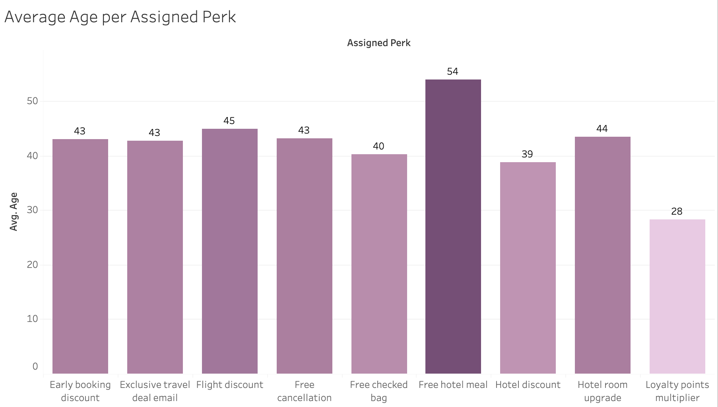
This bar chart displays the average age of users for each assigned perk, highlighting how different perks appeal to different age groups.

Slide 10
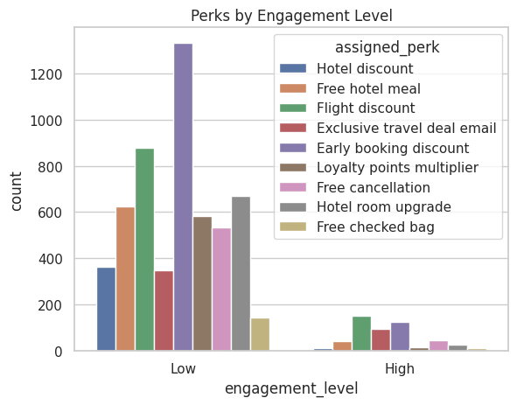
This bar chart compares assigned perks between high and low engagement users. High engagement users prefer perks that reward frequent use (e.g., upgrades), while low engagement users favor simpler perks like free cancellation or discounts.

Slide 11
Reward Strategy Backed by User Insights
We analyzed user behavior to better understand how travelers engage with TravelTide’s platform. By grouping users with similar habits (like how often they travel or how long they stay), we identified meaningful customer segments. Based on these segments, we assigned personalized travel perks—such as free hotel meals, flight discounts, or early booking deals—that best match their needs.
This approach helps ensure each user gets a perk they’re more likely to value, increasing the chances they’ll book again. It also allows TravelTide to target high-value users with premium rewards while encouraging less active users to re-engage with simpler incentives.

Slide 12
Recommendations for Enhancing the TravelTide Rewards Program
🔹 Segment-Based Perk Personalization Assign perks based on distinct user clusters (e.g., business vs. leisure travelers), using K-Means and DBSCAN group insights to match rewards with travel behavior and preferences.
🔹 Engagement-Aware Incentives Differentiate perks for high vs. low engagement users. Offer premium rewards (e.g., room upgrades, loyalty multipliers) to active travelers, and simple, universally attractive perks (e.g., free cancellation) to re-engage less active users.
🔹 Dynamic Reward Optimization Monitor perk uptake and engagement trends across segments. Use feedback loops and behavioral tracking to adapt rewards in real time.
🔹 Future Enhancements Implement tiered loyalty levels to motivate long-term engagement. Integrate A/B testing and user feedback to continuously refine the reward offerings.

Slide 13

Thank you! For questions:
andreacigrovski@gmail.com
Resources:
Google Collab: https://colab.research.google.com/drive/19W1kFJHXrNb5SISZg9zB_rGNHW_EDR0s?usp=sharing
Tableau: https://public.tableau.com/app/profile/andrea.cigrovski/viz/TravelTideProject_17528723614330/Dashboard1
Github: https://github.com/andreacigrovski/TravelTide

